Slide 1


MongoDB

Slide 2
In this section, we will discuss:
Introduction to MongoDB
Features of MongoDB
Create database, collection, Document & Data
Simple Query, Insert select data, filter data
Capped collection, Update & delete Collection
Index and Relationship, Aggregation & grouping, JOIN
Import & export mongo database, Backup restore
database operation with Node +Mongodb

Slide 3

Introduction to MongoDB
Definition
MongoDB is an open-source, cross-platform, and distributed document-based database designed for ease of application development and scaling.
Image Source:
https://tinyurl.com/2v4ya3a2

Slide 4
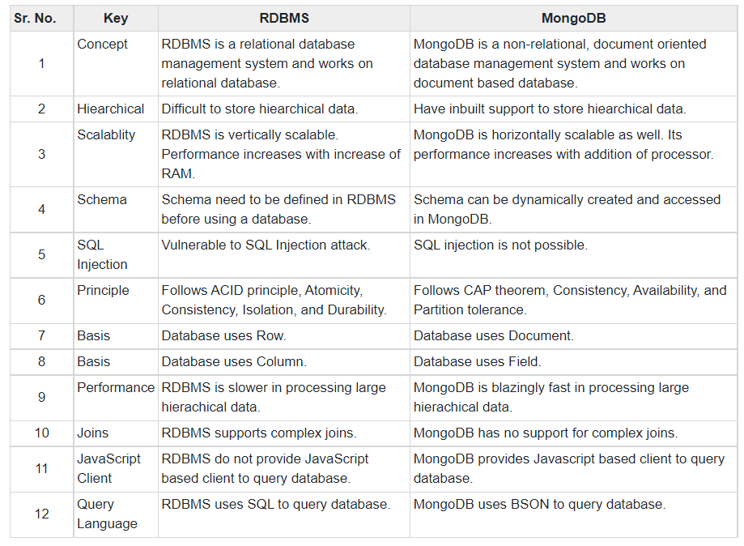
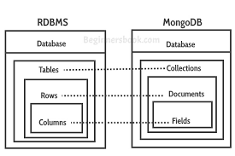
Introduction to MongoDB
Relation between MongoDB and RDBMS
Image Source:
https://tinyurl.com/ycy9psst

Slide 5
Features of MongoDB
Features
Support ad hoc queries
Indexing
Replication
Load balancing
Supports map reduce and aggregation tools.
Uses JavaScript instead of Procedures.
Provides high performance.
Stores files of any size easily without complicating your stack.

Slide 6
Create database, collection, Document & Data
Database
Database is a physical container for collections.
Each database gets its own set of files on the file system.
A single MongoDB server typically has multiple databases

Slide 7
Create database, collection, Document & Data
Database
To create a new database:
use DATABASE_NAME
To check currently selected database:
db
To check databases list:
show dbs

Slide 8
Create database, collection, Document & Data
Field | Type | Description
capped | Boolean | (Optional) If true, enables a capped collection. Capped collection is a fixed size collection that automatically overwrites its oldest entries when it reaches its maximum size. If you specify true, you need to specify size parameter also.
autoIndexId | Boolean | (Optional) If true, automatically create index on _id field.s Default value is false.
size | number | (Optional) Specifies a maximum size in bytes for a capped collection. If capped is true, then you need to specify this field also.
max | number | (Optional) Specifies the maximum number of documents allowed in the capped collection.
Collection
Collection is a group of MongoDB documents.
It is the equivalent of an RDBMS table.
A collection exists within a single database.
Collections do not enforce a schema.
Documents within a collection can have different fields.
Syntax:
db.createCollection(name, options)
name is name of collection to be created. Options is a document and is used to specify configuration of collection.

Slide 9
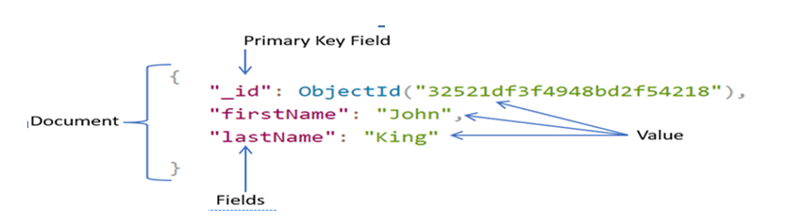
Create database, collection, Document & Data
Document
A document is a set of key-value pairs.
Documents have dynamic schema.
Dynamic schema means that documents in the same collection do not need to have the same set of fields or structure, and common fields in a collection's documents may hold different types of data.
Image Source: https://www.tutorialsteacher.com/Content/images/mongodb/document.png

Slide 10
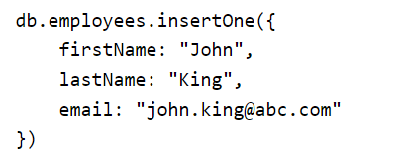
Create database, Collection, Document & Data
Document
insertOne(): to insert a single document in a collection.
db.collection.insertOne(document, [writeConcern])
Where,
document: A document to insert into the collection.
writeConcern (Optional): A document expressing the writeConcern to override the default write concern.

Slide 11
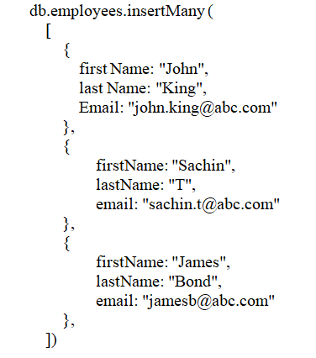
Create database, Collection, Document & Data
Document
insertMany():
To insert a multiple document in a collection.
db.collection.insertMany()
I

Slide 12
Capped collection, Update & delete Collection
Capped Collection
Fixed-size circular collections that follow the insertion order to support high performance for create, read, and delete operations.
Capped collections restrict updates to the documents if the update results in increased document size.
To create a capped collection:
db.createCollection("cappedLogCollection",{capped:true,size:10000})
To collection size, limit the number of documents in the collection using the max parameter
db.createCollection("cappedLogCollection",{capped:true,size:10000,max:1000})
I

Slide 13
Capped collection, Update & delete Collection
Update Collection
db.collection.updateOne(filter, document, options)
db.collection.updateMany(filter, document, options)
Parameters:
filter: The selection criteria for the update, same as find() method.
document: A document or pipeline that contains modifications to apply.
options: Optional. May contains options for update behavior. It includes upsert, writeConcern, collation, etc.
I

Slide 14
Capped collection, Update & delete Collection
Delete Collection
db.collection.deleteOne(filter, options)
db.collection.deleteMany(filter, options)
Parameters:
filter: The selection criteria for the update, same as find() method.
options: Optional. May contains options for update behavior. It includes writeConcern, collation, and hint parameters.
I

Slide 15
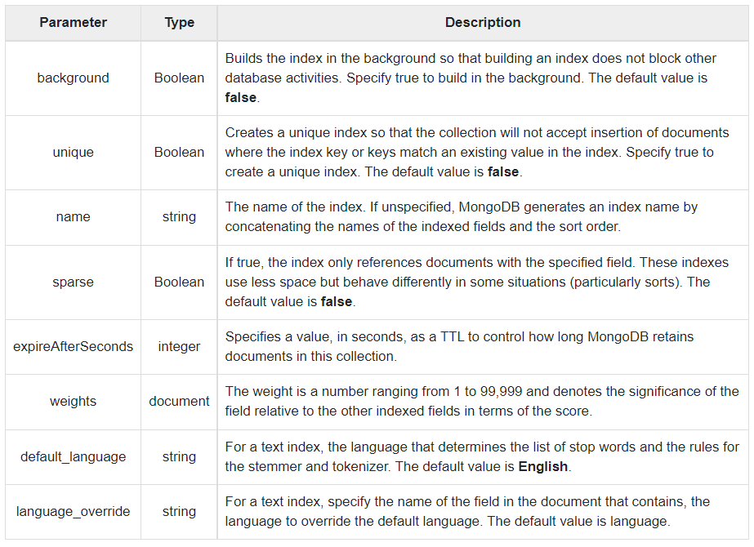
Index and Relationship, Aggregation & grouping, JOIN
Index
Indexes support the efficient resolution of queries.
Indexes are special data structures, that store a small portion of the data set in an easy-to-traverse form.
The index stores the value of a specific field or set of fields, ordered by the value of the field as specified in the index.
The basic syntax of createIndex() method is :
db.COLLECTION_NAME.createIndex({KEY:1})
To create index on multiple fields.
db.mycol.createIndex({"title":1,"description":-1})
I

Slide 16
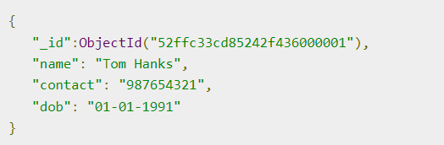
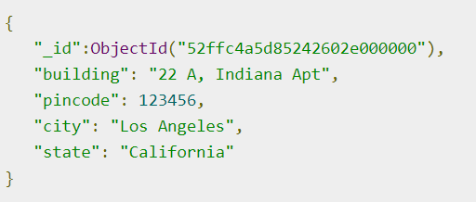
Index and Relationship, Aggregation & grouping, JOIN
Relationship
Relationships in MongoDB represent how various documents are logically related to each other.
Relationships can be modeled via Embedded and Referenced approaches.
Such relationships can be either 1:1, 1:N, N:1 or N:N.
User Document
I
Address Document

Slide 17
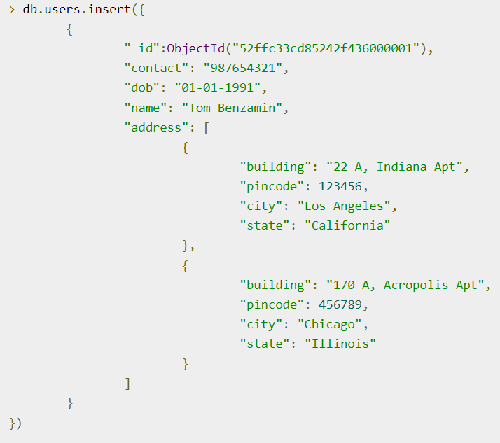
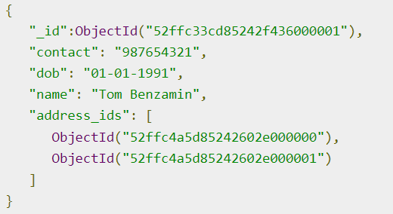
Index and Relationship, Aggregation & grouping, JOIN
Relationship
In the embedded approach, the address document will embed inside the user document.
In Modeling Referenced Relationships both the user and address documents will be maintained separately but the user document will contain a field that will reference the address document's id field.
Modeling Embedded Relationships
I
Modeling Referenced Relationships

Slide 18
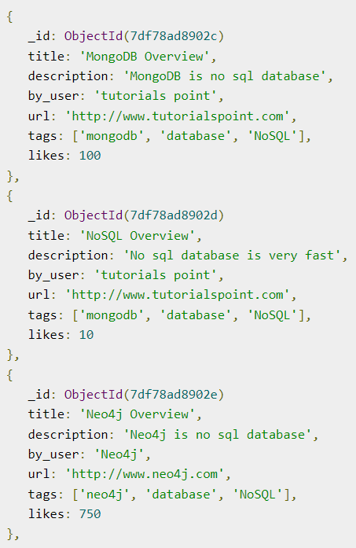
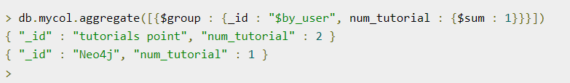
Index and Relationship, Aggregation & grouping, JOIN
Aggregation & grouping
Aggregations operations process data records and return computed results
Aggregation operations group values from multiple documents together, and can perform a variety of operations on the grouped data to return a single result.
In SQL count(*) and with group by is an equivalent of MongoDB aggregation.
db.COLLECTION_NAME.aggregate(AGGREGATE_OPERATION)
I

Slide 19
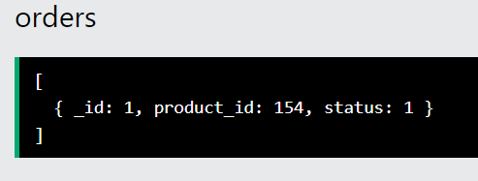
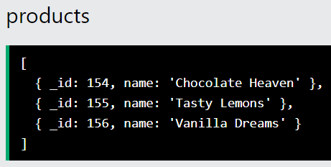
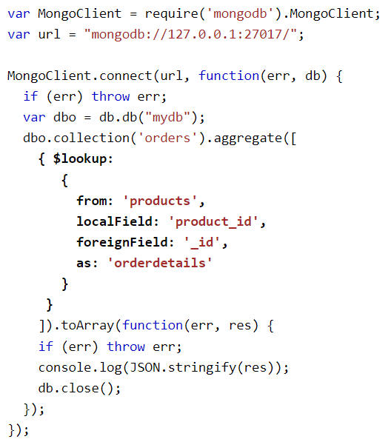
Index and Relationship, Aggregation & grouping, JOIN
JOIN
MongoDB is not a relational database, but but a left outer join can be perform by using the $lookup stage.
The $lookup stage lets specify which collection you want to join with the current collection, and which fields that should match.
db.COLLECTION_NAME.aggregate(AGGREGATE_OPERATION)
I

Slide 20
Import & export mongo database, Backup restore
Import & export , Backup restore
mongoexport: Being used to export data from a Collection to a file (json, csv,..)
mongoimport: Being used to import data to a Collection from a file (json, csv,..)
mongodump: Being used to export all datas of a database to files (Put in a folder), including some files (bson, json)
mongostore: Being used to import all datas to a database from dump directory (Product of mongodump)
I

Slide 21
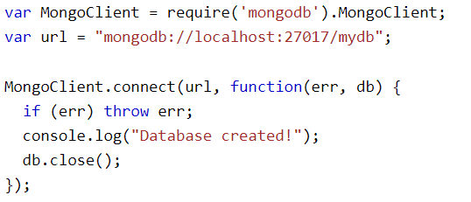
Database operation with Node + Mongodb
Creating a database
To create a database in MongoDB, start by creating a MongoClient object, then specify a connection URL with the correct ip address and the name of the database MongoDB will create the database if it does not exist, and make a connection to it.
I

Slide 22
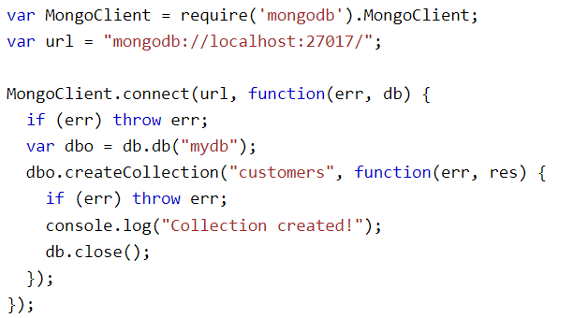
Database operation with Node + Mongodb
Creating a collection
A collection in MongoDB is the same as a table in MySQL.
To create a collection in MongoDB, use the createCollection() method:
I

Slide 23
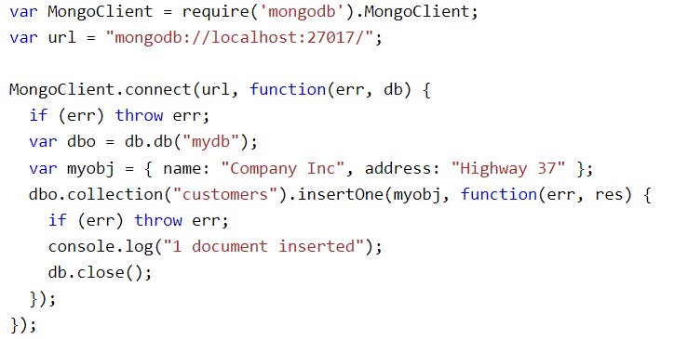
Database operation with Node + Mongodb
Insert Into Collection
A document in MongoDB is the same as a record in MySQL.
insertOne() method:
The first parameter of the insertOne() method is an object containing the name(s) and value(s) of each field in the document to be insert.
I

Slide 24
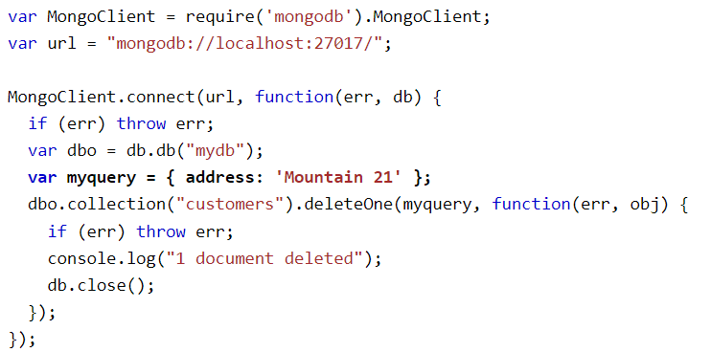
Database operation with Node + Mongodb
Delete Document
deleteOne() method
The first parameter of the deleteOne() method is a query object defining which document to delete.
If the query finds more than one document, only the first occurrence is deleted.
I

Slide 25
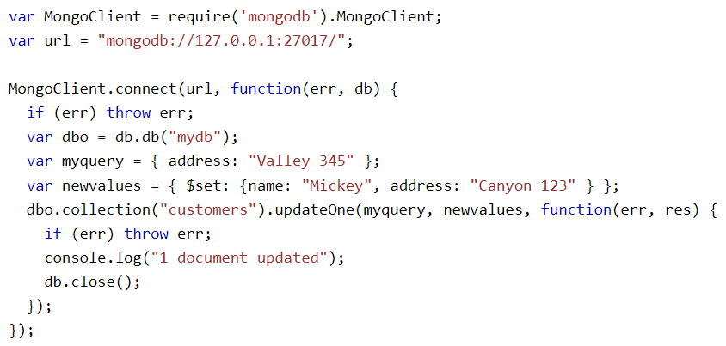
Database operation with Node + Mongodb
Update Document
updateOne() method
The first parameter of the updateOne() method is a query object defining which document to update. The second parameter is an object defining the new values of the document.
If the query finds more than one record, only the first occurrence is updated.
I

Slide 26
Database operation with Node + Mongodb
Update Document
updateOne() method
The first parameter of the updateOne() method is a query object defining which document to update. The second parameter is an object defining the new values of the document.
If the query finds more than one record, only the first occurrence is updated.
I

